Slide 1
Elfie Architecture
Scott Louvau, 01/15/2016

Slide 2
Elfie Overview
ELFIE: Extensible Lightweight Fast Indexing of Entities
Managed, in memory index of code members and additional data [signatures, locations – arbitrary]
Very compact, minimal allocation, rapid serialization
Supports Search, Go To Definition, Add Package through one API
Search is zero allocation, zero boxing, zero string creation
Can run locally or in cloud environment
Dependency free [Non Roslyn languages supportable]

Slide 3
Elfie Types
PackageDatabase – Full Fidelity package/binary/sln declaration map
AddReferenceDatabase – Public Types across packages only
MergedMembersDatabase – Single merged namespace hierarchy
Required Components:
ItemTree for Declarations
StringStore to hold string values
Index for search

Slide 4
String Store
Index
Matches
PackageDatabase
S0 “”
S1 C:
S2 Collections
S3 Contains
S4 HashTable
S5 HashTable.cs
S6 List
S7 List.cs
S8 object
S9 System
0: { S2 [Collections], M0}
1: { S3 [Contains] , M1}
2: { S4 [HashTable] , M3}
3: { S6 [List] , M4}
4: { S9 [System] , M5}
0: D2 [Collections]
1: D4 [Hashtable.Contains]
2: D6 [List.Contains]
3: D3 [Hashtable]
4: D5 [List]
5: D1 [System]
One per Package
Contains:
Declared Members
File Locations
Search Index
All arrays / structs
One copy of each string in StringStore
Serializes very quickly
StringStore: 2 arrays.
Index: 3 arrays.
Declarations: 4 arrays.
Details: 3 arrays*
Locations: 3 arrays*
File Tree: 4 arrays.
Total: 19 arrays.
Declaration Tree
Details (kind, mods, params)
Locations
D0: {Empty}
D1: S8 [-> System ]
D2: S2 [ -> Collections ]
D3: S4 [ -> Hashtable ]
D4: S3 [ -> Contains ]
D5: S6 [ -> List ]
D6: S3 [ -> Contains ]
0: {Package, ,S0[“”]}
1: {Namespace, , S0[“”]}
2: {Namespace, , S0[“”]}
3: {Class, Public, S0[“”]}
4: {Method, Public , S8[object]}
5: {Class, Public, S0[“”]}
6: {Method, Public, S8[object]}
0: F0 | Ln 0 | Ch 0
1: F0 | Ln 0 | Ch 0
2: F0 | Ln 0 | Ch 0
3: F4 [Hashtable.cs]| Ln 6 | Ch 8
4: F4 [Hashtable.cs] | Ln 32 | Ch 12
3: F5 [List.cs]| Ln 10 | Ch 10
4: F5 [List.cs] | Ln 68 | Ch 14
File Tree
F0 {Empty}
F1 C:
F2 -> System
F3 -> Collections
F4 -> Hashtable.cs
F5 -> List.cs
Notes:
Flow:
Type ‘List’
Binary look-up in the string store, retrieves ‘S5’
Binary look-up ‘5’ in Index and retrieve D4 (additional look-up to support common string store, with per-package index)
D4 used to retrieve any other details around the symbol

Slide 5
String Store
Index
Matches
AddReferenceDatabase
S0 “”
S1 C:
S2 Collections
S3 Contains
S4 HashTable
S5 HashTable.cs
S6 List
S7 List.cs
S8 object
S9 System
0: { S2 [Collections], M0}
1: { S3 [Contains] , M1}
2: { S4 [HashTable] , M3}
3: { S6 [List] , M4}
4: { S9 [System] , M5}
0: D2 [Collections]
1: D4 [Hashtable.Contains]
2: D6 [List.Contains]
3: D3 [Hashtable]
4: D5 [List]
5: D1 [System]
One for a set of Packages
Contains:
Declared Members
Search Index
StringStore: 2 arrays.
Index: 3 arrays.
Declarations: 4 arrays.
Details: 1 array.
Total: 10 arrays.
Declaration Tree
Details (kind)
D0: {Empty}
D1: S8 [-> System ]
D2: S2 [ -> Collections ]
D3: S4 [ -> Hashtable ]
D4: S3 [ -> Contains ]
D5: S6 [ -> List ]
D6: S3 [ -> Contains ]
0: {Package}
1: {Namespace}
2: {Namespace}
3: {Class}
4: {Method}
5: {Class}
6: {Method}
Notes:
Flow:
Type ‘List’
Binary look-up in the string store, retrieves ‘S5’
Binary look-up ‘5’ in Index and retrieve D4 (additional look-up to support common string store, with per-package index)
D4 used to retrieve any other details around the symbol

Slide 6
Elfie Performance
Roslyn.sln [~225k members, 114 binaries, 116MB DLL size]
Full Index currently ~14MB (RAM and Disk)
Search/Go To Definition ~1M/sec
All NuGet latest public types [1.59M types]: 57MB [ARDB], 39MB [TXT], 8MB [TXT ZIP]
“Popular” NuGet [95% of downloads]: 14MB [ARDB], 9MB [TXT], 1.8MB [TXT ZIP]

Slide 7
Design Details
Mutable and Immutable data structures [separate fast crawl from fast search]
ConvertToQueryable or ConvertToImmutable pattern
Strings are sorted, in one UTF8 byte[], and assigned int IDs
Prefix searches map to a single int range
Index matches are in sorted word order, so prefix matches are a contiguous range in a single array
Tree and Index are sorted during crawl by popularity and then alphabetical so runtime ranking isn’t needed

Slide 8
Query Workflow [Multi-Part string]
Convert string to UTF-8 bytes (String8)
Split into parts [System|Collections|Generic|Arr]
Binary search StringStore for each string part
Get index array matches for last complete word (Generic)
Check ancestors match remaining name parts (System.Collections.Generic?)
Walk children to match incomplete suffic (Generic.Array, Generic.ArrayList)

Slide 9
Future Scenarios
Great Command Line interop [any command, open in VS, open in GitHub]
Call Graph and Find All References
VSIX for build integrated index creation
Index and Search annotations (comments, static analysis messages, …)

Slide 10
Azure Scaling Concept [Old]
VS | VSCode
http://coby
Azure CPU Scaling
Indexes in Azure Storage
Indexers can scale
CodeDB instances can load 1/n of data
Azure duplicates instances on load for us
Azure distributes queries for us
One scaled “front end” merges results
Web Service
...
Scanner
[Detect NuGet Releases]
Azure CPU Scaling
Azure CPU Scaling
Azure CPU Scaling
CodeDatabase
CodeDatabase
CodeDatabase
1/3
2/3
3/3
NuGet
Azure Queue
[To Crawl]
CodeDatabase
CodeDatabase
CodeDatabase
Azure Queue Scaling
Indexer
1/3
2/3
3/3
SymbolSource
Indexer
GitHub
...
...
...
...
Azure Queue
[Just Crawled]
Azure Storage
IDX
IDX
IDX
IDX
IDX
IDX
IDX
IDX
IDX

Slide 11
Just My Code Crawl Diagram
Bin\Debug
One.dll [1/19/2016]
One.cs [1/12/2016]
One.pdb [1/19/2016]
Reference.cs
Reference.dll
Ref2.dll
Sample.cs
Ref2.pdb
Bin\Release
One.dll [1/4/2016]
[Included]
One.pdb [1/4/2016]
[Excluded]

Slide 12
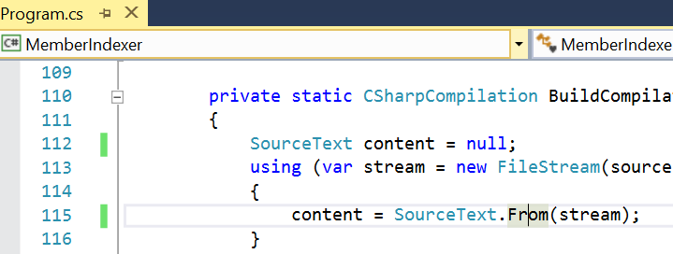
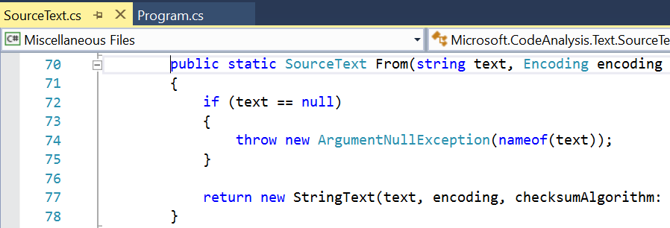
DTE ->
C:\Code\Demo\MemberIndexer\Program.cs(115, 28)
CommandLine.dll
MemberIndexer.dll
Microsoft.CodeAnalysis.dll
Microsoft.CodeAnalysis.Csharp.dll
Newtonsoft.Json.dll
…
Roslyn Compilation -> [all binaries + Program.cs]
Microsoft.CodeAnalysis.Text.SourceText.From(string, Encoding, SourceHashAlgorithm)
SourceText SourceText.cs(18)
From(byte[], int, Encoding, ...) SourceText.cs(154)
From(Stream, Encoding, ...) SourceText.cs(102)
From(string, Encoding, ...) SourceText.cs(70)
Elfie Index -> [from DLL + PDB + Sources]
https://raw.githubusercontent.com/dotnet/roslyn/version-1.1.0
src/Compilers/Core/Portable/Text/SourceText.cs
C:\SymbolCache\Microsoft.CodeAnalysis.pdb\src\9c3786a5\SourceText.cs(70)
Notes:
F12 with Elfie can find more declarations than VS does today, using locations from PDBs built anywhere on your machine or source-indexed PDBs from the internet.
How does Elfie-powered F12 [Go To Definition] work?
We get the source file open and cursor position from the DTE.
We build a Roslyn Compilation with all of the project output binaries. This means it knows about all public and private symbols needed for compilation of the code and any dependent code.
We add the open file to the Roslyn compilation as a SyntaxTree.
We ask Roslyn to identify the token at the cursor position and resolve it to a Symbol.
We ask Elfie to find the declaration location for the identified Symbol.
Roslyn has the context to identify any symbol with the metadata, but doesn’t know locations.
Roslyn can even resolve dependent code since it has the whole dependency tree.
Elfie has declaration locations from metadata, symbol, and source crawls.

Slide 13
Database Distribution Diagram
Central Service
NuGet.org
[Native Database]
Client [First Run]
Package1
Binary1.dll
Namespace1
Class1
Class2
…
[Native Database Subset]
Search Results
Download Text
[Text Model – 2/7]
[Text Model – 2/7]
[Diffs from …]
…

Slide 14
Database Distribution Diagram
Central Service
NuGet.org
[Native Database]
Client [Next Run]
Package1
Binary1.dll
Namespace1
Class1
Class3
…
[Native Database Subset]
Search Results
[Text Form – 2/8]
Download Difference
[Text Form – 2/8]
[Diffs from 2/7]
[Diffs from 2/7]
Apply Differences
[Text Model – 2/7]
[Text Model – 2/7]
[Diffs from …]
…

Slide 15
My Other Code
My Company Code
My Open Solution
OSS [NuGet | GitHub | …]
Frameworks [BCL]

Slide 16
Experience Gaps
Finding Code
Navigation
Refactoring
Debugging

Slide 17
My Other Code
Elfie
My Company Code
My Open Solution
MemberIndexer
OSS [NuGet | GitHub | …]
CommandLine
Newtonsoft.Json
Roslyn
Frameworks [BCL]
mscorlib

